Slide 1


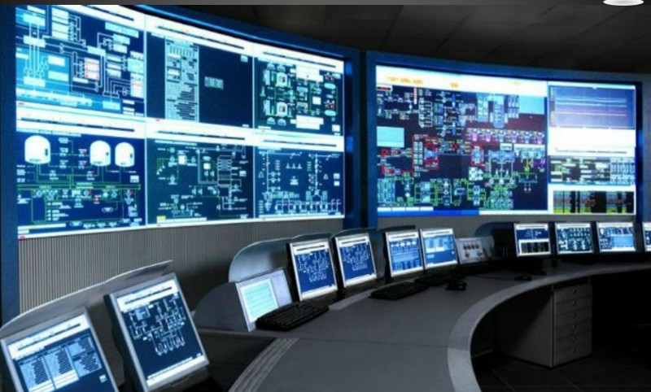
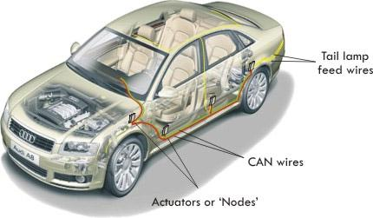
RWDA - BINFO - Summer semester
CAN && LIN
Ricardo Cartaxo
Esteves Tiago
Pedro Gomes

Slide 2
Index
Introduction CAN && LIN
CAN architecture
LIN architecture
CAN Data transmission protocol
LIN Data transmission protocol
APIs
Security concerns (CAN && LIN)
Conclusion

Slide 3

History
CAN-bus
Stands for "Controller Area Network"
Almost every new car has at least one CAN network
Developed by Robert Bosch GmbH
Developpement started in 1983
ISO 11898 standard was published in 1993

Slide 4
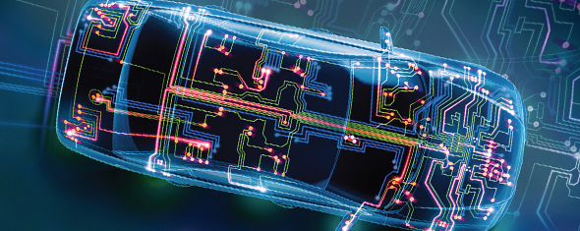
History
Why was the new protocol needed?
No other network protocol could fulfill the requirements of automotive engineers
high-integrity serial bus system
networking in a real-time performance
low weight
low cost
high-bandwidth
Notes:
Can you make slides 3 - 4 together ?

Slide 5





History
LIN-bus
Stands for "Local Interconnect Network"
LIN consortium was set up by five car manufacturers
Developpement started in 1990
LIN 2.0 was introduced in 2003

Slide 6
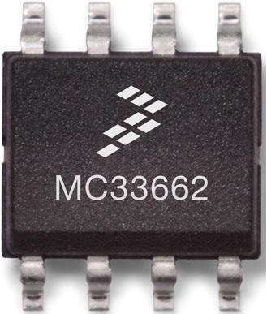
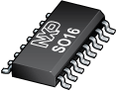
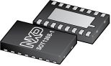
History
Why was LIN needed?
CAN's costs adds up with number of electronic systems
not every system needs the benefits of CAN
LIN aimed at tackling compatibility issues

Slide 7
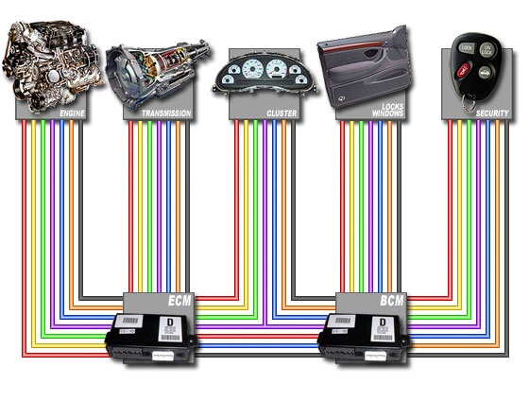
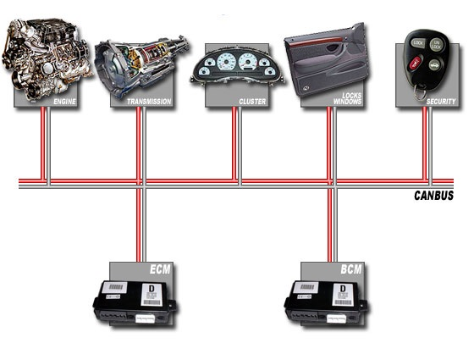
CAN Architecture
Wiring

Slide 8
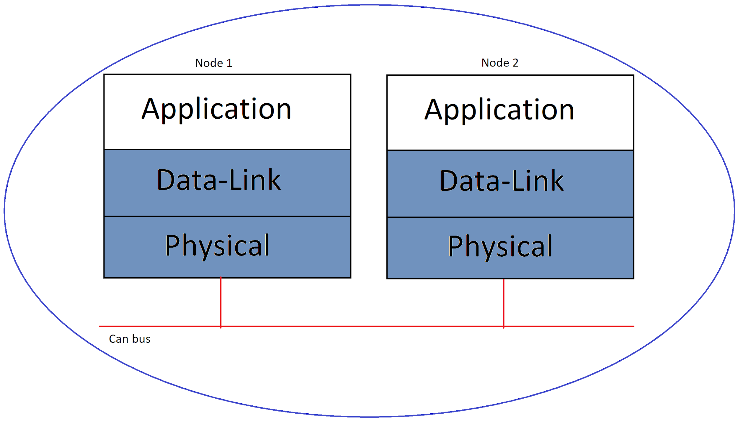
CAN Architecture
Nodes
Application Layer
Microcontroller
Processes and requests data from the network
Data-Link Layer
CAN controller
Sends messages to the network
Controls the quality of messages received
Physical Layer
CAN transceiver
Converts 1's and 0's into electrical pulses and back

Slide 9
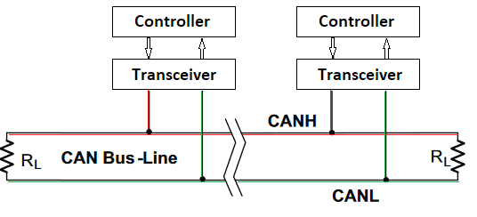
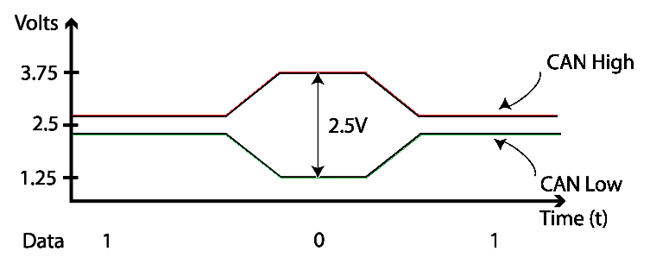
CAN Architecture
Wires and voltage
when idle, both lines carry 2.5 volts (recessive signal)
when sending a dominant signal
CANH is brought to ~3.5 volts
CANL is lowered to ~1.5 volts
all transceivers compare the difference in the voltage of both wires

Slide 10
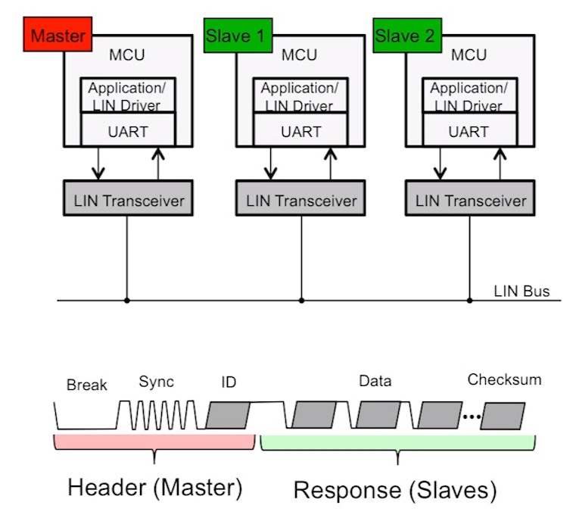
LIN Physical Layer
Quick Facts
Based on ISO 9141 (K-Line)
Master/Slave Organisation
Synchronization:
Master: oscillating device
Slave(s): synchronization pulse
One Single Wire + Ground
Maximum cable length: 40m
1 - 20 kb/s max. speed
Dominant {0} / Recessive Bits {1}
Terminations:
Master 1k𝛀
Slave 30k𝛀
MCU -> Microcontroller Unit
UART -> Universal asynchronous receiver-transmitter

Slide 11
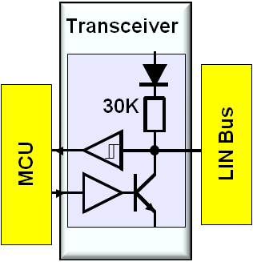
LIN Physical Layer Transceiver
LIN-bus transceiver == mod of the transceiver used by the ISO 9141 standard
LIN bus operational range: 9V - 18V.
Typically an MCU operates at 5V
Therefore, the LIN MCU I/O pins voltage levels are adjusted by a transceiver.
Note: A node can have more than one transceiver (f.ex for: multiple lights)

Slide 12
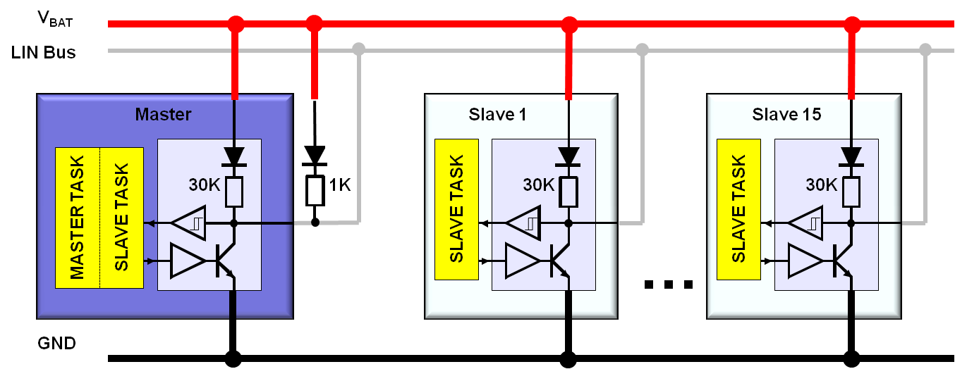
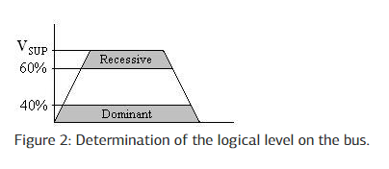
LIN Physical Layer
Determination of Logic Values
Logical high ‘1’
Logical low ‘0’
Notes:
Can you make slides 12-13 together ?

Slide 13
CAN Data transmission protocol
Lossless bitwise arbitration :
Pseudo Code:
T = Transmit
X,Y = All nodes on the CAN BUS
C1():
If (X+Y) T 0 :
(X+Y) see 0
C2():
If (X+Y) T 1:
(X+Y) see 1
C3():
If (X T 0) && (Y T 1):
(X+Y see 0) && (Y stops T 1)
0
Dominant
1
Receiver

Slide 14
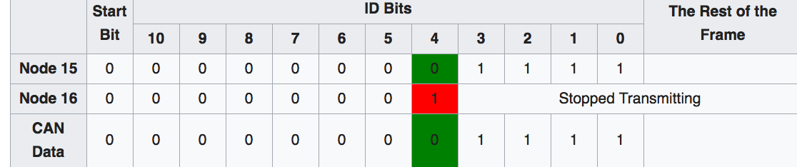
Example
C1
C3
STOPS && Queues its message for later transmission.
15 in binary: 1111 + Padding = 000000001111
16 in binary: 10000 + Padding = 000000010000
11 bits frame : 0 Dominant
29 bits frame : 1 Dominant

Slide 15
Bit Timing && Synchronization
Data Rate : 500kbits/sec
Bit Timing :
Synchronization
|
|____ Hard Sync(1)
|
|____ Soft Sync(2)
(1) : When all nodes are IDLE(only once)
(2) : Several times after Hard Sync
1 Data Rate
1 / 500kbits/sec = 2 microseconds, Which means 1 bit is sent every two microseconds.

Slide 16
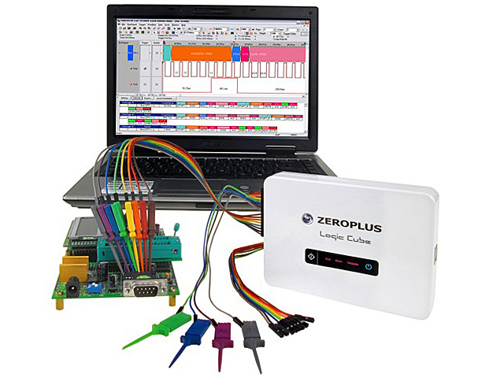
Logging Functions

Slide 17

LIN Protocol & Data Transmission
Quick Facts
Serial, bidirectional, byte oriented communication (one byte at a time)
Files used:
LCF File (determines Frame Slots / Scheduling Table)
LDF File (contains info on Frames and Signals)
Scheduling Table
Master Task & Slave Task(s)
Nodes communicate one at a time
-> else: collision
Method of communication: “LIN Frames”
Communication always initiated by Master Task (send Header)

Slide 18
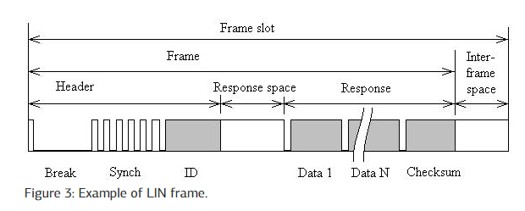
LIN Protocol & Data Transmission
Frames
What is a Frame?
A Frame is basically a message
A Frame is sent in a Frame Slot (determined by the LCF)
2 main parts: Header + Response
4 types of Frames:
Unconditional (1)
Event-Triggered (2)
Sporadic (3)
Diagnostic (new to LIN 2.x)

Slide 19
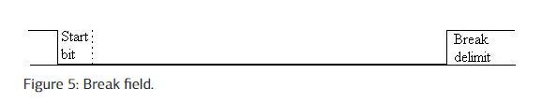
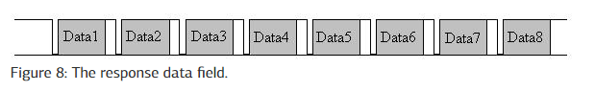
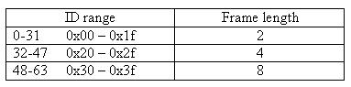
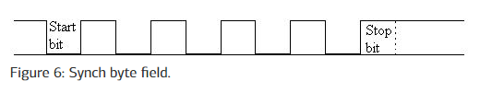
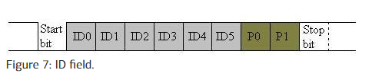
LIN Protocol & Data Transmission
Frames (Header) + (Response)

Slide 20
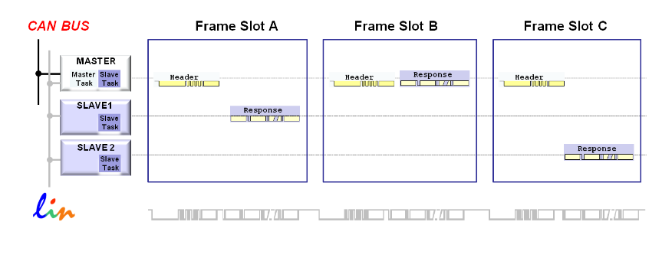
LIN Protocol & Data Transmission
Frame Types (1)
Unconditional Frame(s)
“Normal type of LIN communication”
The master sends a Frame Header, then the designated node fills the Frame Response with data.

Slide 21
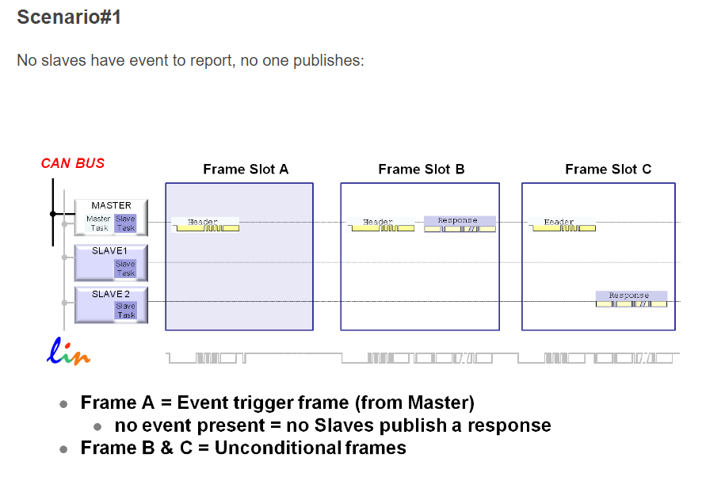
LIN Protocol & Data Transmission
Frame Types (2)
Event-Triggered Frame(s)
“Increases responsivity of the LIN cluster, without using up too much bandwidth, ignoring nodes which have nothing/no changes to report.”
Master asks slaves if a certain event has occurred
Witnesses publish a response
Collisions are possible - If more than one slave has detected the specified event, all respond simultaneously, resulting in a collision
Collision -> MASTER reverts to unconditional frames

Slide 22
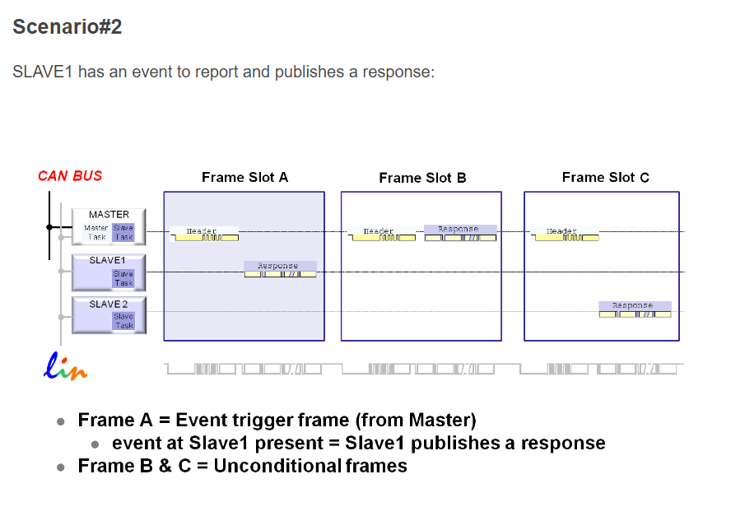
LIN Protocol & Data Transmission
Frame Types (2)
Event-Triggered Frame(s)
“Increases responsivity of the LIN cluster, without using up too much bandwidth, ignoring nodes which have nothing/no changes to report.”
Master asks slaves if a certain event has occurred
Witnesses publish a response
Collisions are possible - If more than one slave has detected the specified event, all respond simultaneously, resulting in a collision
Collision -> MASTER reverts to unconditional frames

Slide 23
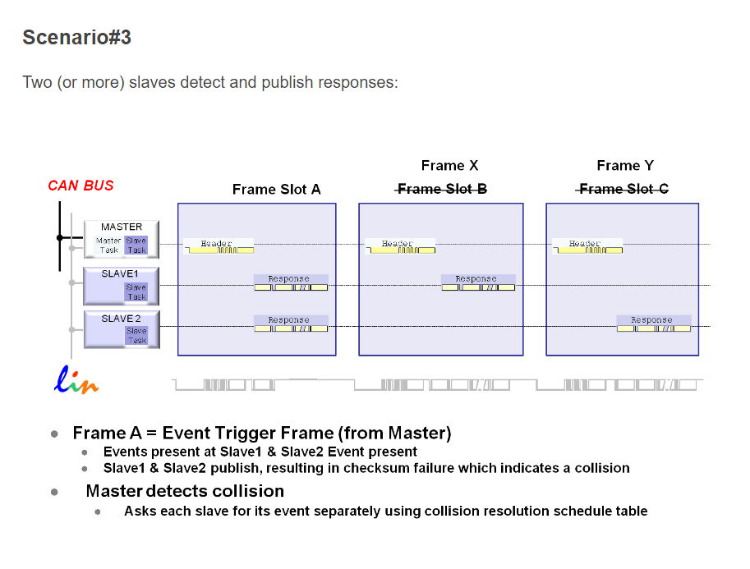
LIN Protocol & Data Transmission
Frame Types (2)
Event-Triggered Frame(s)
“Increases responsivity of the LIN cluster, without using up too much bandwidth, ignoring nodes which have nothing/no changes to report.”

Slide 24
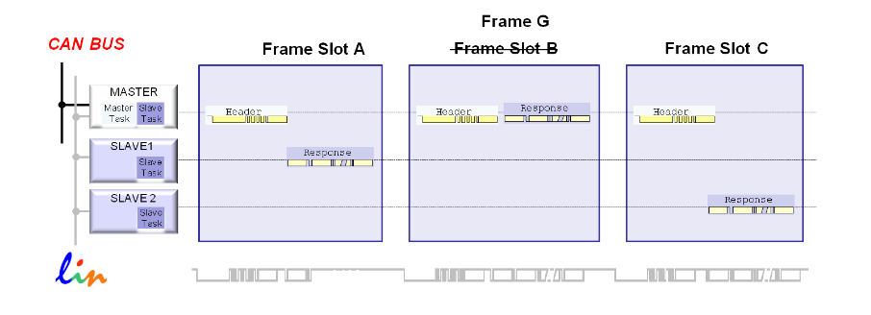
LIN Protocol & Data Transmission
Frame Types (3)
Sporadic Frame(s)
Sent by Master when it is know that a slave has updated data

Slide 25
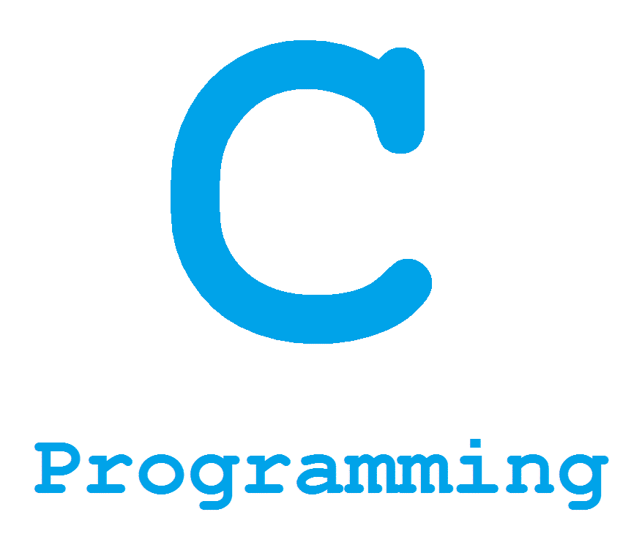



APIs
C/ C++/ C# :
CAN_BUS_Shield : open source project :
CheersLights : open source project :
CANopen API : not open source : need to pay:
Python :
Python-CAN : Open Source + Easy to use + Very active + Good Documentation
CanTools : Open Source ; CANard : Open source + Good documentation
Swift :
I2C : Not for CAN.
Java :
LibSock-CAN-Java
CANmonitor
CANClient

Slide 26

Security Concerns
!!DAMN vulnerable!!
|
|__> Does not support any security features
|
|__> No Encryption
Why ?
Complexity
Cost
CAN ID
Attack ? :
USB -> Del Logs -> DoS Attack !
Reverse engineer firmware -> malicious firmware
Protection ?
->Layered defense in depth.
->Separate Crucial Buses
DoS_Example.py (Black Hat Asia 2015, by Eric Evenchick)
from canard import can
from canard.hw import cantact
# create and start device
dev =cantact.CantactDev('/dev/cu.usbmodem14514') dev.start()
# create our payload frame
frame = can.Frame(id=0) frame.dlc = 8
# spam!
while True:
dev.send(frame)

Slide 27
Questions?

Slide 28
Ressources:
http://esd.cs.ucr.edu/webres/can20.pdf https://www.br-automation.com/en/products/networks-and-fieldbus-modules/can-bus/lossless-bit-wise-bus-arbitration/
https://security.stackexchange.com/questions/88724/is-there-any-protection-against-malicious-devices-on-a-can-bus
https://www.youtube.com/watch?v=8_c3VxBiW-E
https://www.can-cia.org/can-knowledge/can/can-history/
http://www.ni.com/white-paper/2732/en/
http://www.ti.com/lit/an/sloa101b/sloa101b.pdf
http://canbuskits.com/what.php
http://www.techzibits.com/about-techzibits/hi-tech-industries/automotive-electronics/
https://www.nxp.com
https://www.infineon.com
http://www.axiomatic.com/whatiscan.pdf

